Slide 1
St. Paul Street Evangelization
Building a bridge of trust between
the world and the Catholic Church.

Slide 2
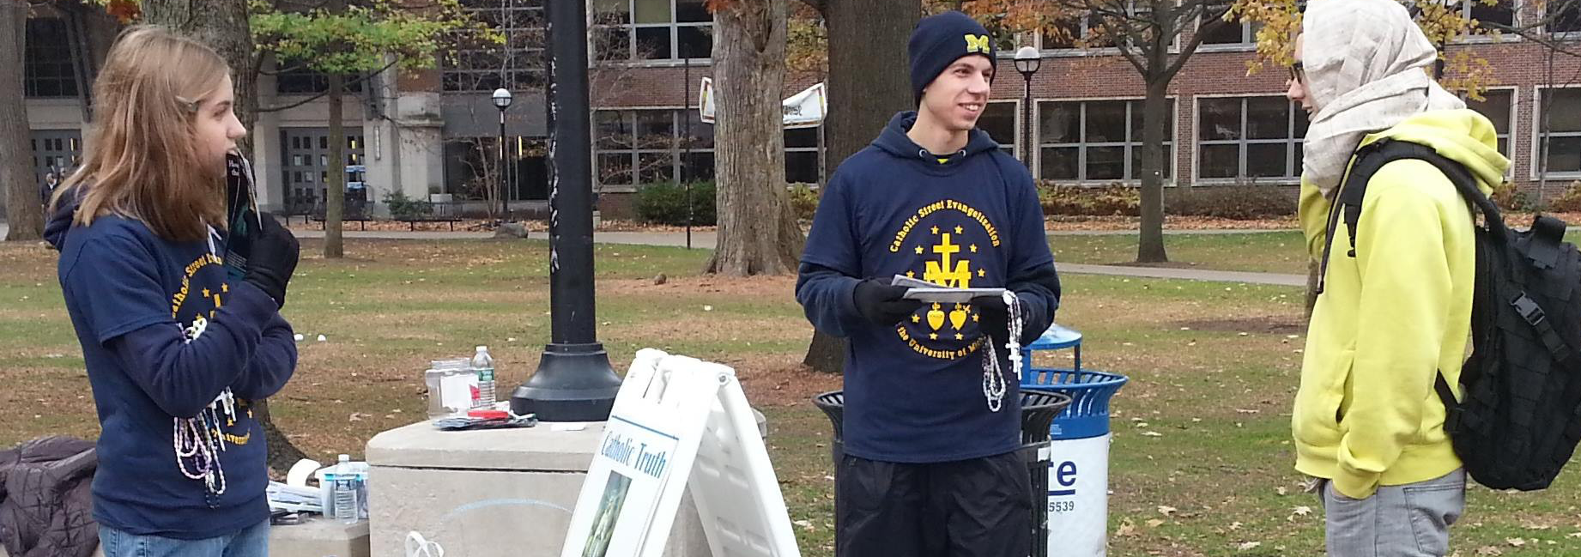
© 2014 St. Paul Street Evangelization
All Rights Reserved.
Mass distribution, distribution online, any form of publication is not permitted without written permission. You may make up to 20 printed copies to hand out.

Slide 3
Opening Prayer
Come, Holy Spirit!
Set our hearts on fire with zeal for the Gospel, love for all people,
and the desire for their salvation.
Inspire us that we might proclaim the Gospel persuasively and with charity,
giving witness with our words and our lives.
Give us courage in proclaiming the Lordship of Jesus Christ,
and the truth, beauty, and goodness of our Catholic faith.
We beg you also to open the hearts of all people,
helping them to know Your love and Your call to the fullness of life in Your Church.
Through our holy patrons, Our Lady of Guadalupe and St. Paul,
we ask these graces for all the evangelists of St. Paul Street Evangelization
and those of us here, and we make this prayer in the name of Jesus Christ, Our Lord. Amen.

Slide 4
Why st. Paul street evangelization?
The truth is not that we do not want to share our faith, but that most of us are not practiced at sharing our faith with others. It is not out of lack of desire to help others better their own lives, we just don’t know how to start and do not want to seem “weird”.
This talk will introduce you to the work of St. Paul Street Evangelization and give you a few simple ideas on how to share the truth in love (out of the concern for the good of the other).
It is our hope you will join us in this work!
National Contact: Adam Janke, Program Director
adam@stpaulse.com
517.455.5592

Slide 5
What is SPSE?
St. Paul Street Evangelization (SPSE) is a grassroots, non-profit organization, dedicated to responding to the mandate of Jesus to preach the Gospel to all nations by taking the Catholic Faith to the streets. Christ’s call to evangelize was made to every Catholic Christian, and the Second Vatican Council reiterated this need, urging each of the baptized to bring the Gospel, found fully in the Catholic Church, to a culture that has largely reverted to paganism. As an on-the-street Catholic evangelization organization, St. Paul Street Evangelization provides an avenue for people to share the Person of Jesus Christ and the truth and beauty of the Catholic Faith with a hungry culture.
The Holy Spirit will give us the strength we need to go outside of the norm and create a new normal – a New Evangelization. We just need to give Him permission to take us there.

Slide 6
What do we do?
Armed with a simple sign, pamphlets and Rosaries, SPSE evangelists take to the streets, going wherever people are gathered – on a street corner, at a festival, or even at a football game. Our teams always begin in prayer. Unlike some forms of street evangelism which seek to forcibly proselytize those passing by (for example, by yelling, displaying confrontational signs, or preaching loudly at no one in particular), SPSE employs a non-confrontational method, maintaining a peaceful presence and allowing people to approach if they choose. Initial contact is limited to a friendly greeting and an offer of a free Rosary, but the evangelist never tries to force anyone to stop and talk.

Slide 7
Now is the time
“God is opening before the Church the horizons of a humanity more fully prepared for the sowing of the Gospel. I sense that the moment has come to commit all of the Church's energies to a new evangelization and to the mission in the world. No believer in Christ, no institution of the Church can avoid this supreme duty: to proclaim Christ to all peoples.” – St. John Paul II

Slide 8
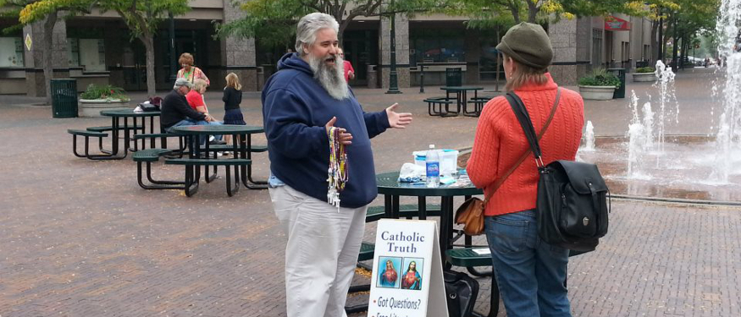
The joyful proclamation

Slide 9
The approach
St. Paul Street Evangelization has found this non-confrontational approach to be very effective at strengthening the faith of practicing Catholics, bringing back into the Faith fallen away Catholics, and clearing up misconceptions about the Faith held by non-Catholics. While it is the mission of SPSE to work with God for the conversion of the whole world to the Catholic Faith, SPSE evangelists recognize that it is only their job to plant seeds, and in the end, it is up to God to make those seeds grow.
The goal of St. Paul Street Evangelization is not to win arguments but to share the love of Jesus Christ with a hurting culture that is seeking truth.

Slide 10
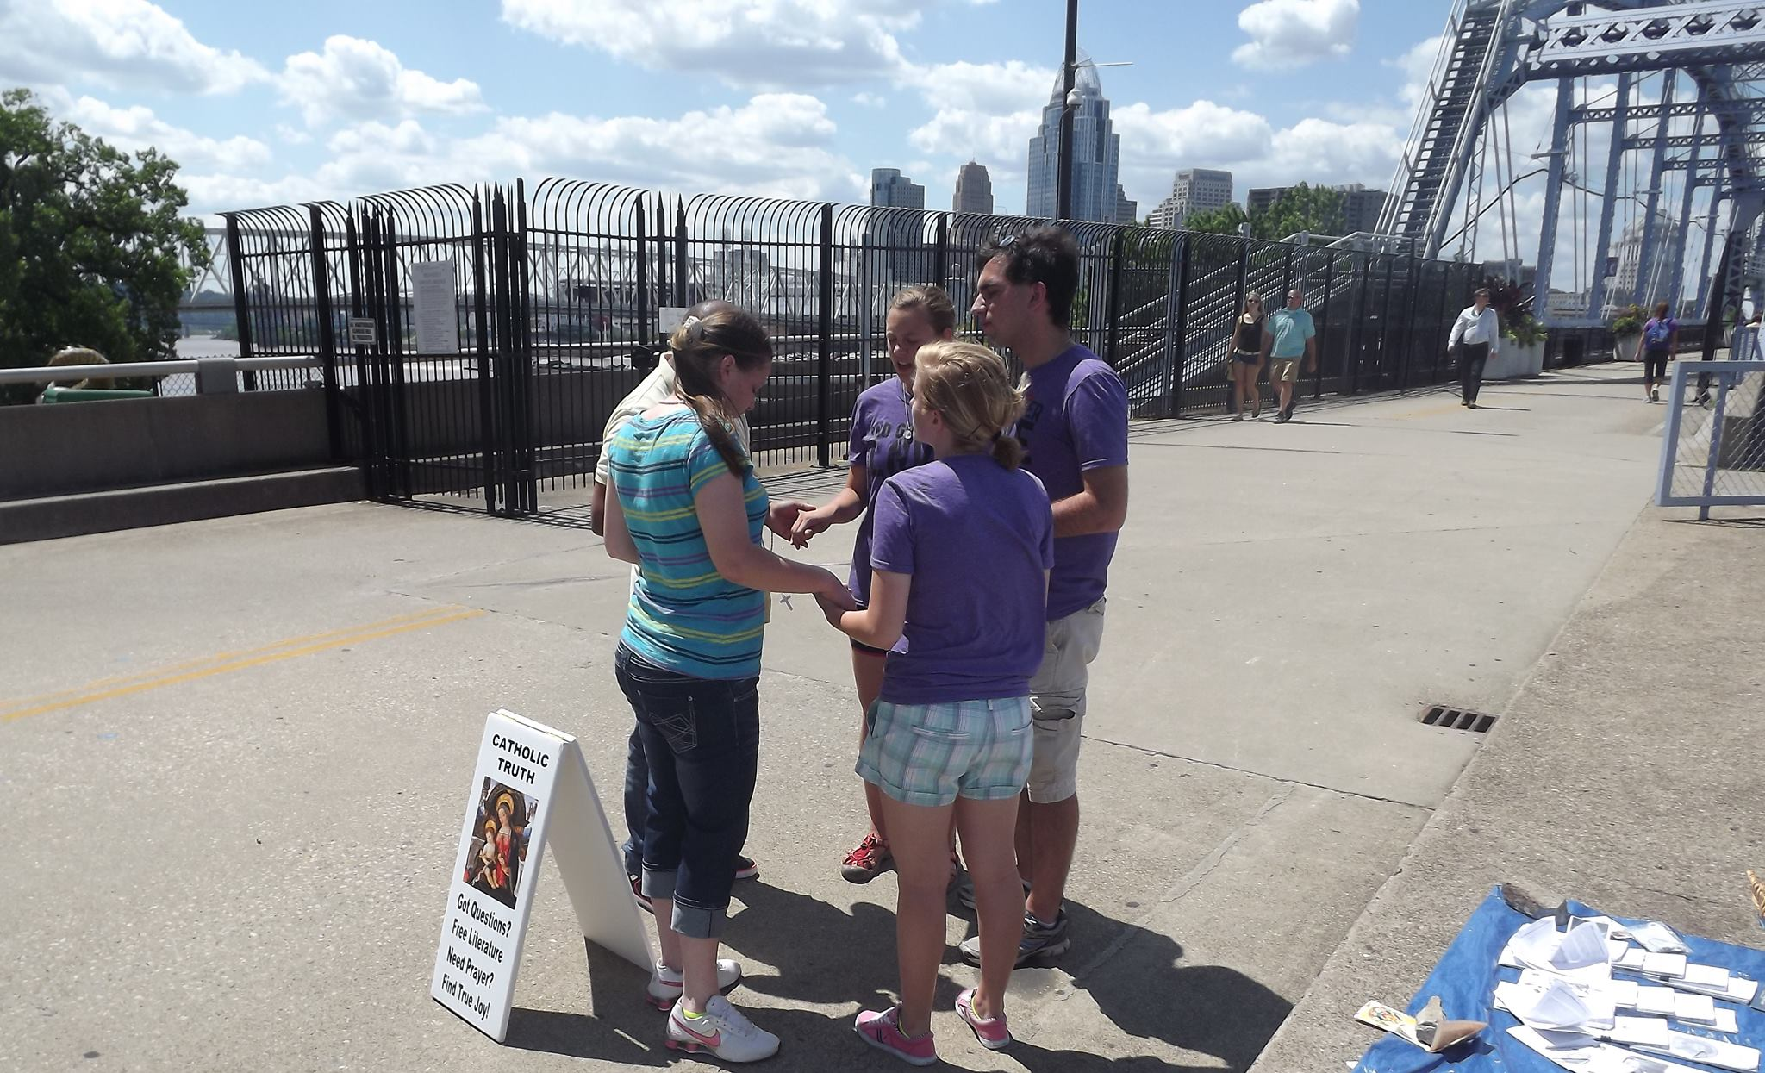
Prayer is the center of our work.

Slide 11
Hearts on fire
We need our hearts set on fire by the Gospel.
“A true missionary, who never ceases to be a disciple, knows that Jesus walks with him, speaks to him, breathes with him, works with him. He senses Jesus alive with him in the midst of the missionary enterprise. Unless we see him present at the heart of our missionary commitment, our enthusiasm soon wanes and we are no longer sure of what it is that we are handing on; we lack vigour and passion. A person who is not convinced, enthusiastic, certain and in love, will convince nobody.” – Pope Francis

Slide 12
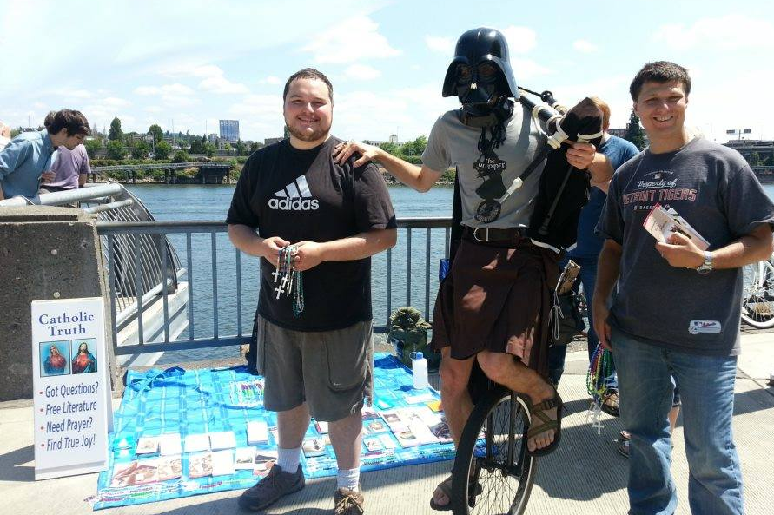
This is fun!

Slide 13
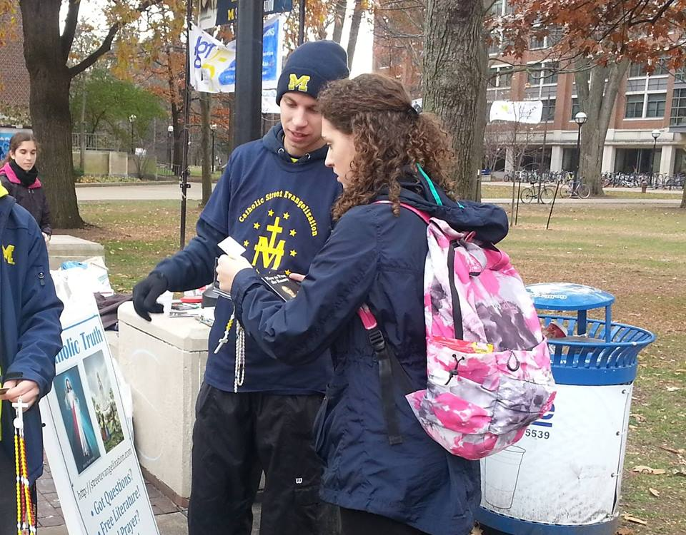
And effective!
Thousands hear the Gospel!
Hundreds return to Church!
New relationships are forged!
It’s easy, energizing, fruitful,
and fun!
Don’t be afraid! You can
do this!
Lives are saved from
suicide & abortion!

Slide 14
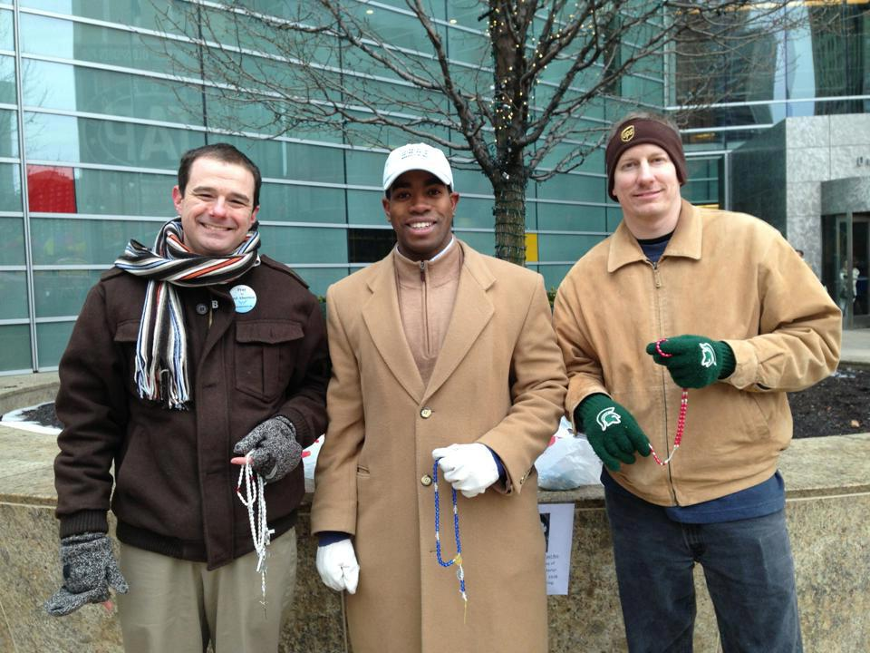
You can do this!
When out on the streets, the evangelists of SPSE share the hope that is in them so that the world sees the salvation of God through the Church that He founded. They do not evangelize because they have done any great thing, but because God has done a great work in them, and for that, they are humbled. A person does not need to be a theologian or professional apologist to be an effective evangelist. He only needs to have a heart for Jesus Christ and His Church and be willing to share that with others.

Slide 15
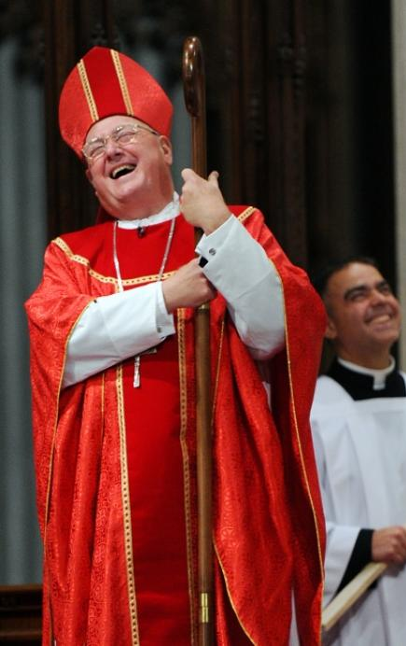
Be a joyful evangelist. Smile!
1 Peter 1:8-9

Slide 16
Be a Joyful Evangelist
“When the Church summons Christians to take up the task of evangelization, she is simply pointing to the source of authentic personal fulfilment. Consequently, an evangelizer must never look like someone who has just come back from a funeral!
Let us recover and deepen our enthusiasm, that “delightful and comforting joy of evangelizing, even when it is in tears that we must sow… And may the world of our time, which is searching, sometimes with anguish, sometimes with hope, be enabled to receive the good news not from evangelizers who are dejected, discouraged, impatient or anxious, but from ministers of the Gospel whose lives glow with fervour, who have first received the joy of Christ”. – Pope Francis, EG 10

Slide 17
Share the Story.
Psalm 30:5

Slide 18
Give away miraculous medals.
Luke 1:27-28

Slide 19
Give away medals
Put them in a rosary pouch and carry them with you.
Say: “I would like to give you a gift. Our Lady appeared to St. Catherine Laboure in 1830 and stated that who ever wears the Miraculous Medal will receive great graces from God. Many miracles are associated with the medal which is why it is called miraculous.”

Slide 20
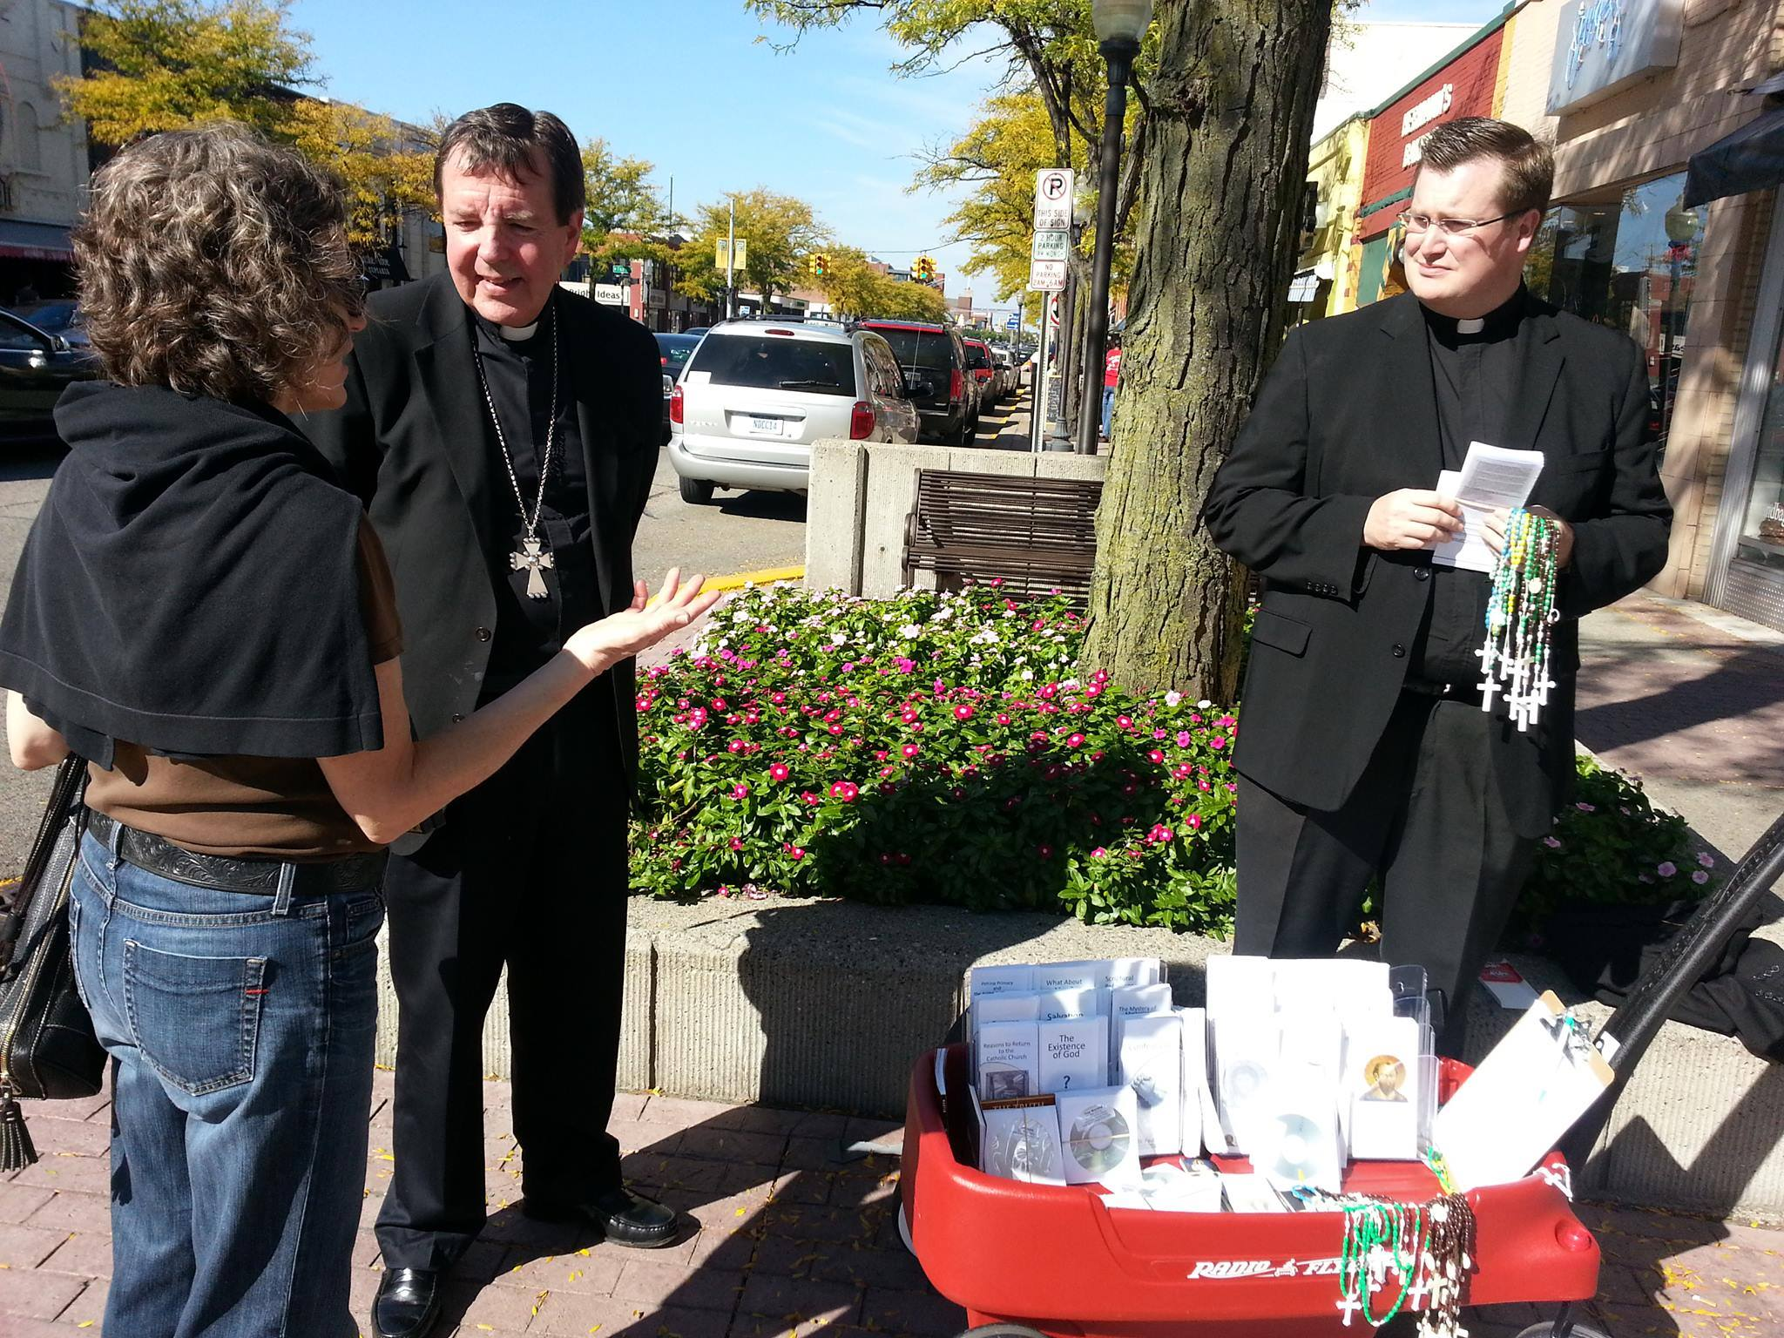
Learn how to listen instead of hear. Be genuinely interested in others.
James 1:19

Slide 21
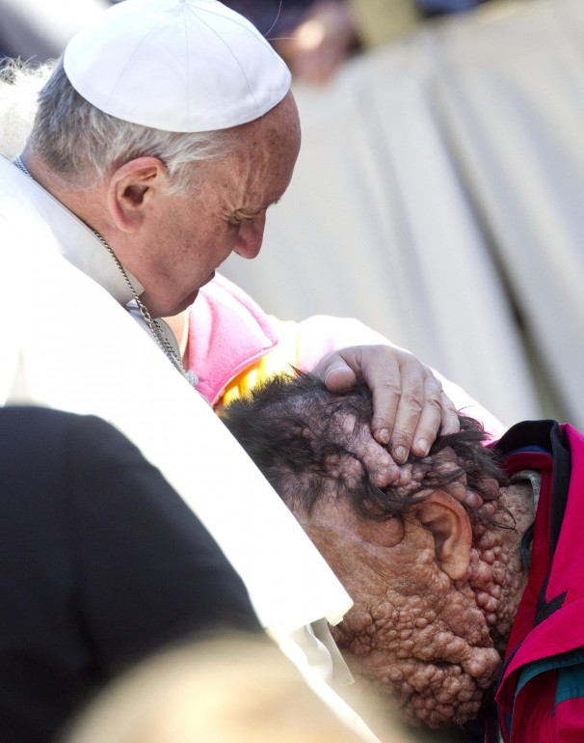
Love the sick & the poor.
Matthew 25:31-46

Slide 22
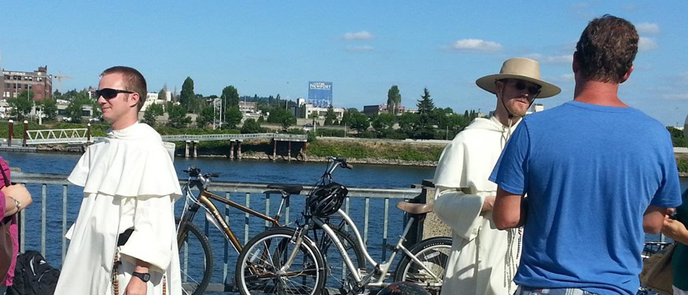
Do not complain or criticize others. Find common ground.
Philippians 2:14-15

Slide 23
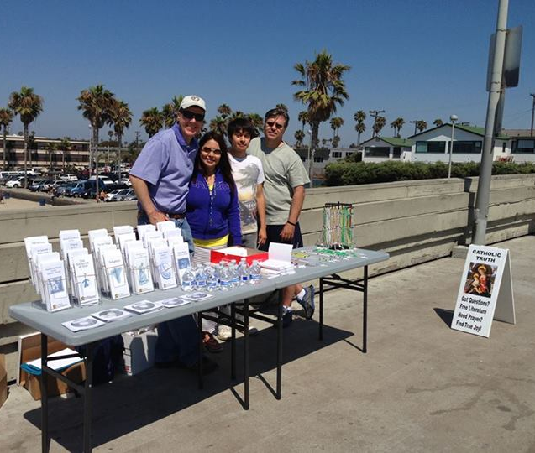
Join or start an SPSE street team. It’s free.
Acts 17:22-23

Slide 24
Join & Support SPSE
It’s free to:
Start a team.
Join a team.
It’s easy
There is no easier method of evangelizing.
Put these ideas into practice.
It is energizing, not energy draining.
It is fun. You meet a lot of new people.
Very few people are hostile.

Slide 25
[Supporting] Membership
Full access to our training website and certification courses with updates and new training modules each month.
Access to live training video conferences.
Supporting Members have access to our Members Store which carries our resources (such as Miraculous Medals, holy cards, signs, postcards, and T-Shirts) at highly discounted rates.
Access to all of our pamphlets in PDF format for you to print out and distribute at no charge. Access to professional audio talks.
Access to all of the other various resources and templates that our team leaders use around the country.
The knowledge that your contributions will be well spent for the conversion of our entire world to Christ and His Church.
$15 a month or FREE.
Support us by Prayer.
Stay informed & spread the word.

Slide 26
www.streetevangelization.com
Fill out the Get Involved tab.
Sign up to become a supporting member.
Click on the locations tab and decide if you want to start a team or join a local team.
Join us on Facebook.
Follow the stories of Catholic evangelists.
Become a prayer warrior or an apologist.
National Contact:
Adam Janke, Program Director
adam@stpaulse.com
517.455.5592

Slide 27
Closing Prayer
St. Michael the Archangel, defend us in battle. Be our defense against the wickedness and snares of the Devil. May God rebuke him, we humbly pray, and do thou, O Prince of the heavenly hosts, by the power of God, thrust into hell Satan, and all the evil spirits, who prowl about the world seeking the ruin of souls. Amen.

Slide 28
St. Paul Street Evangelization
Building a bridge of trust between
the world and the Catholic Church.

